Slide 1

A Decision Framework for Locating a Professional Services Business, Selecting Between San Francisco, CA and Seattle, WA

Slide 2

CONTENTS
• Introduction:
• Business Location Decision: Project Description
• Project Focus and Target Audience
• Data Requirements and APIs Referenced
• Decision Methodology
• Corporate Financial Impact Factors - Analysis
• Results
• Discussion
• Conclusion

Slide 3
Introduction: Project Description
Project Description and Business Decision
This data science project proposes a decision structure to address the decision:
Where should I locate a professional services business, selecting between two
neighborhoods that each have a concentration of high-tech startup companies?
Example possibilities for the professional services business are:
• Providing data science and data research services to tech companies
• Facilities planning and facilities location research services
• Professional human resources contract services
• On-site health care and monitoring services
• Security services such as IT software hosting and security, or personnel for onsite security monitoring

Slide 4
Project Focus and Target Audience
This project focuses on two neighborhoods noted for their burgeoning growth of technology startups:
• San Francisco, CA: South of Market Street region (SoMa)
• Seattle, WA: Pioneer Square region
Target Audience and Their Interest in This Problem:
• CEOs, entrepreneurs, and venture capital companies looking to evaluate where to establish a new professional services business.
• These audiences would care about this data analysis because the study provides a decision framework for where to locate a business, with data sources, with the thesis that professional services businesses generate greater success when they are located near their clients.

Slide 5
Data Requirements:
APIs and Datasets Utilized in This Analysis
• Foursquare Venues Database API
• For Commercial Real Estate Availability and Pricing, I accessed three commercial R.E. listing websites, and from these constructed a database:
• CityFeet.com
• 42Floors.com
• Loopnet.com
• State and City Corporate Income Tax References, for California/San
Francisco and Washington/Seattle

Slide 6
Business Decision Methodology
Decision Methodology, Description of the Data, and How It Will Be Used to Solve the Business Problem. This business location decision framework focuses on the Financial Impact to the Company
• Assess Financial Impact to the Company, focusing on these factors:
1) Commercial Real Estate Rental/Lease Prices for office real estate in each region, to rent/lease a facility for company operations
2) Corporate Tax Rates for each state and city

Slide 7
Corporate Financial Impact Factors for the Business Location Decision
1) Commercial Office Real Estate: property characteristics, locations, and rental/lease costs, based on current commercial office properties available at the time of this study.
• Constructed two commercial real estate listings datasets, one for each city,
with these fields for analysis and comparisons:
a) Property Address
b) Neighborhood and Zip Code
c) Rental Price per Month
d) Property Area in Square Feet
e) Rental Price per Square Foot per Year
• Sources for Commercial Real Estate properties and availability in San Francisco and Seattle:
https://www.cityfeet.com, https://42floors.com, https://www.loopnet.com

Slide 8
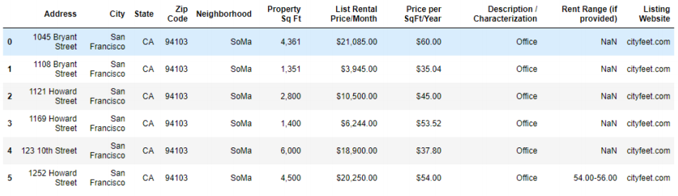
San Francisco / SoMa: Commercial Real Estate Database

Slide 9
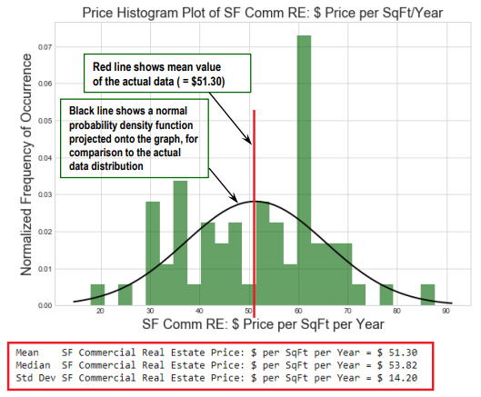
Commercial Real Estate Rental Prices:
San Francisco / SoMa District (June 2019)
• San Francisco / SoMa Comm RE
Price Statistics:
• Mean = $51.30
• Median = $53.82
• StdDev = $14.20

Slide 10
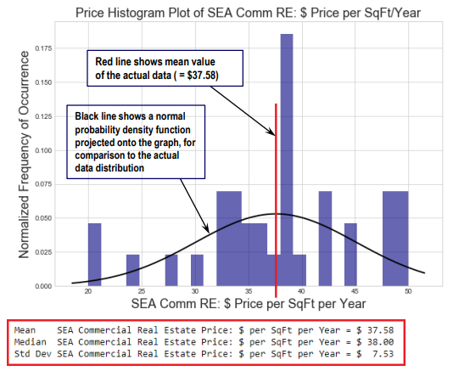
Commercial Real Estate Rental Prices:
Seattle / Pioneer Square Area (June 2019)
Seattle / Pioneer Square Comm RE
Price Statistics:
• Mean = $37.58
• Median = $38.00
• StdDev = $ 7.53
• Both the SEA price mean and
standard deviation are lower than
for SF (previous slide)
Conclusion: Seattle / Pioneer
Square commercial office real
estate prices are lower than in San
Francisco / SoMa, with higher
confidence

Slide 11
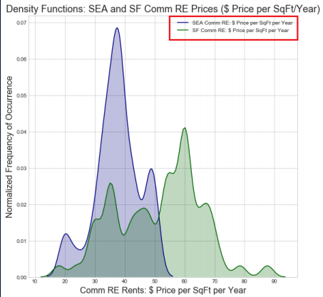
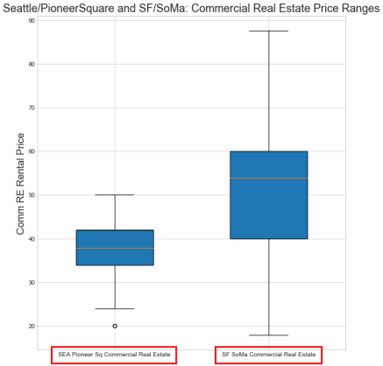
Distances from Comm RE Properties to Public Rail
Transportation: SEA / Pioneer Sq and SF /SoMa
Conclusions:
• Seattle / Pioneer Square shows lower price statistics for mean, median, and standard deviation, relative to prices in the San Francisco / SoMa district.
• Seattle / Pioneer Square offers the prospect of lower office space location cost, relative to San Francisco / SoMa.

Slide 12
Corporate Financial Impact Factors (cont'd.)
2) Corporate Tax Rates by State and City
• To calculate financial impact of corporate business taxes, I calculated two tax planning scenarios for a C corporation located in each neighborhood, based on the percent of gross receipts (gross sales), or percent of net income before taxes, as appropriate for the state and city.
• State of California and San Francisco City Corporate Tax References:
https://www.ftb.ca.gov/businesses/index.shtml, https://sftreasurer.org/business
• State of Washington and Seattle City Corporate Tax References:
https://dor.wa.gov/find-taxes-rates/business-occupationtax, https://www.seattle.gov/business-licenses-and-taxes

Slide 13
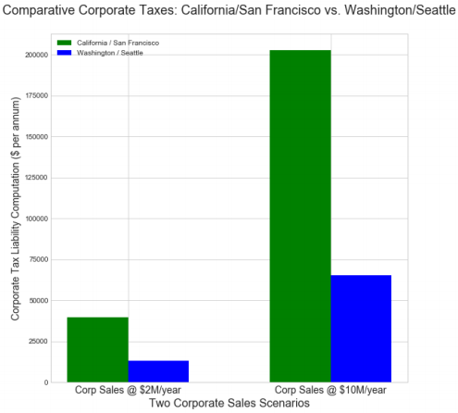
Projected Corporate Tax Computations:
SF / SoMa vs. SEA / Pioneer Square
California and San Francisco tax rates for C corporations are higher than for Washington and Seattle, respectively:
• California business tax rate = 8.84% on Corporate Net Income
• San Francisco Corporate Gross Receipts Tax: scales with sales revenues; 0.46% for $2M sales, 0.51% for $10M sales.
• San Francisco Payroll Expense Tax = 0.38%, for corporate entities with a personnel payroll exceeding $300K/year.
• Washington business tax rate: 1.5% on Corporate Net
Income
• Seattle City Gross Receipts Tax: 0.427% on Gross Receipts.
The graphs at right show comparative corporate tax computations for SF and SEA, for two corporate sales scenarios
Conclusion: locating a business in Seattle should have lower corporate tax liability for comparable sales levels.

Slide 14
Results: Business Location Decision Analysis for
Two Neighborhoods
Decision Factor | San Francisco / SoMa | Seattle / Pioneer Square
Commercial Real Estate Rental Prices | More expensive: mean Comm RE price = $51.30 / SqFt / year | Less expensive: mean Comm RE price = $37.58 / SqFt / year
State and City Corporate Taxes | Higher corporate taxes: CA / San Francisco corporate taxes are approx. 3X those in WA / Seattle | Lower corporate taxes: WA / Seattle corporate taxes are approx. 1/3 those in CA / San Francisco

Slide 15
Discussion of Results
Based on the analysis above, Seattle / Pioneer Square contributes a significantly lower corporate financial cost and shows to be a more attractive technology startup business location.
However, there are clearly additional factors to consider for the location of a technology-based professional services company startup, especially:
• Access to skilled technology personnel to staff the specific business
• If the firm is venture capital funded, then the VCs' preferences for location are clearly important

Slide 16
Conclusion: Battle of the Neighborhoods
Decision on Where to Locate a Professional Services Business:
Based on the analysis in this data science study on where to locate a professional services company, I would prioritize locating the professional services business in Seattle / Pioneer Square, a location with a significantly lower corporate costs than in San Francisco

